Slide 1

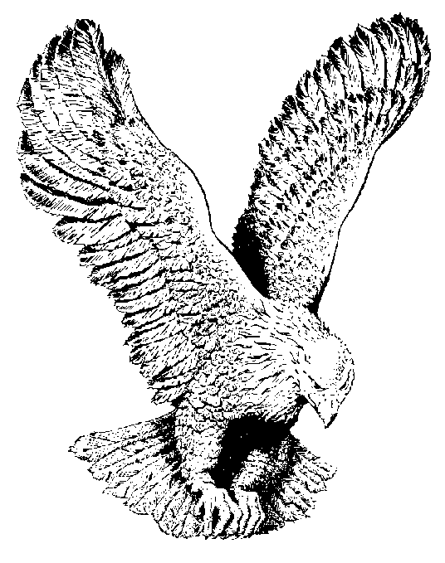
WE ARE STANDING
We are standing on holy ground
And I know there are angels all around,
Let us praise Jesus now,
We are standing in his presence
On Holy ground

